Slide 1
INDIAN RESTAURANTS in CHICAGO
Locate a neighborhood with best Indian Restaurants for tourists
Locate the best neighborhood for an entrepreneur to start his business

Slide 2
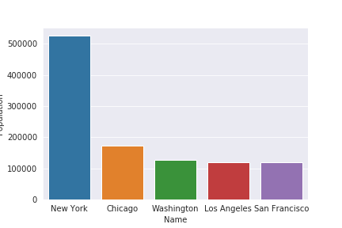
Business Problem :
An entrepreneur wants to start a new Multi Cuisine Indian restaurant in CHICAGO. Since he believes that Chicago is one of the most densely populated Indian immigrant states in US. So he approaches a Data Scientist for a suggestion where to start his business. (source from wikipedia)

Slide 3
Role of Data Scientist :
Since being a Data Scientist we need to solve his problem and recommend the best neighborhood of chicago to start his business.
Roles involves :
.
Finding all the Neighborhoods with INDIAN Restaurants.
Finding all the Neighborhood with out single INDIAN Restaurants.
Finding the best place and most visited INDIAN Restaurant.
Suggest best Neighborhood for starting business.

Slide 4
Approach followed :
We consider some metrics to solve this problem
Number of INDIAN restaurants in neighborhood
Distance of neighborhood from the center of the city
Is there any tourist places to visit
The optimal place to start business is a location where there are less INDIAN restaurants, Minimum distance from the center of city and there are some popular tourist places to visit.

Slide 5
Data Gathering
For this project we need following data :
First we need all the neighborhoods of Chicago along with their latitude and longitude coordinates.
Data Source : https://en.wikipedia.org/wiki/List_of_neighborhoods_in_Chicago
Description: Wikipedia has a list of Neighborhood of Chicago, we scrap it using python libraries and get its location coordinates using geopy.geocoder library in python.
Indian restaurants in each Neighborhood of CHICAGO
Data Source : FourSquare API
Description: By using this API we will get all the venues in each neighborhood. We can filter this venues to grab only INDIAN restaurants

Slide 6
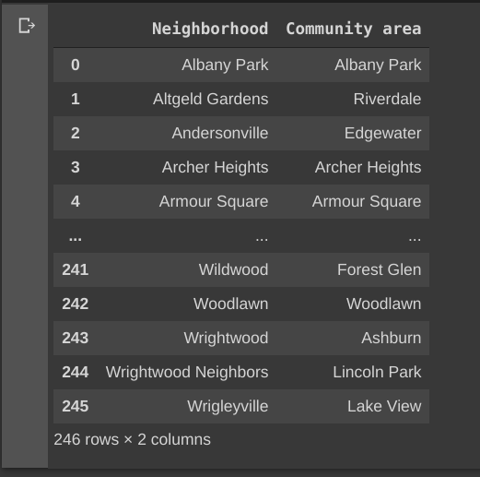
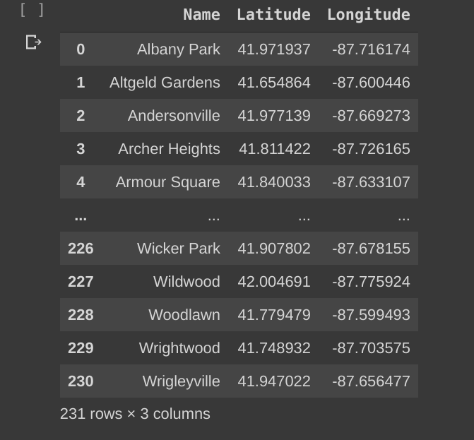
Modeling :
Data from Wikipedia Location coordinates from Geopy library

Slide 7
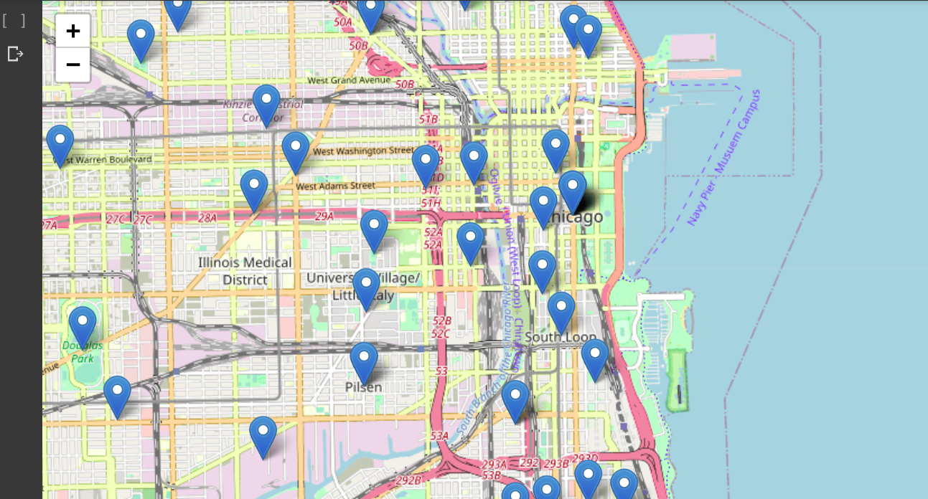
Visualizing the Neighborhoods of Chicago

Slide 8
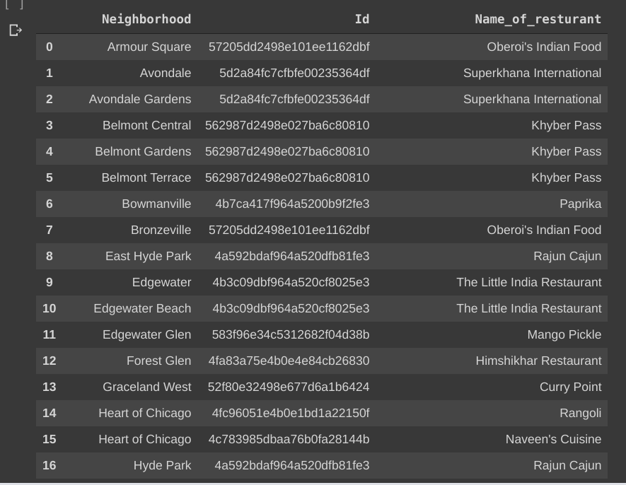
Retrieving INDIAN restaurants from FoureSquare API

Slide 9
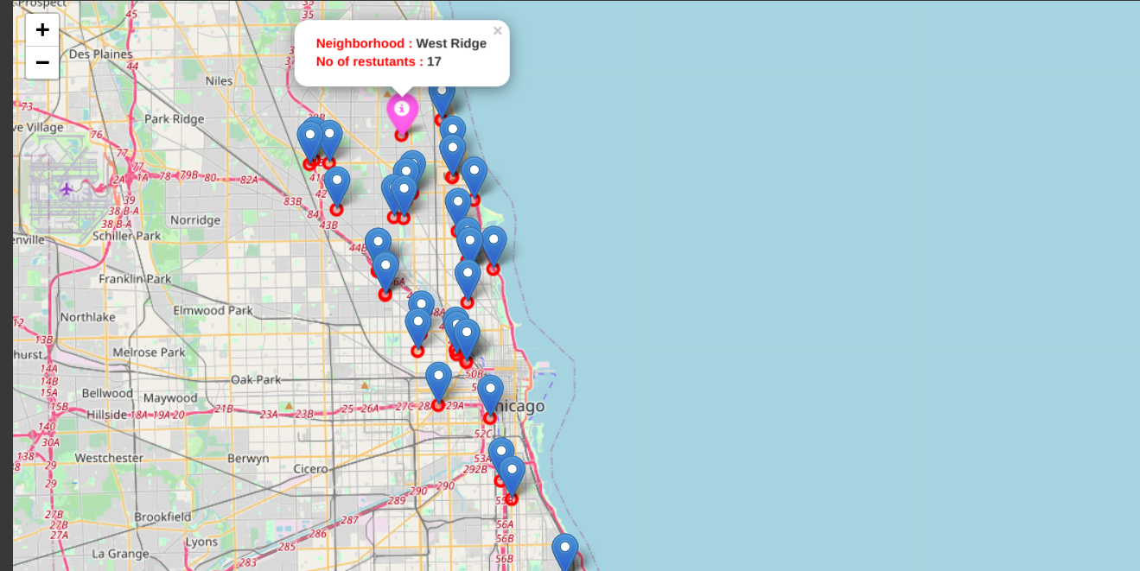
Visualization of INDIAN restaurants
Pink Marker is the location where there are many INDIAN restaurants.

Slide 10
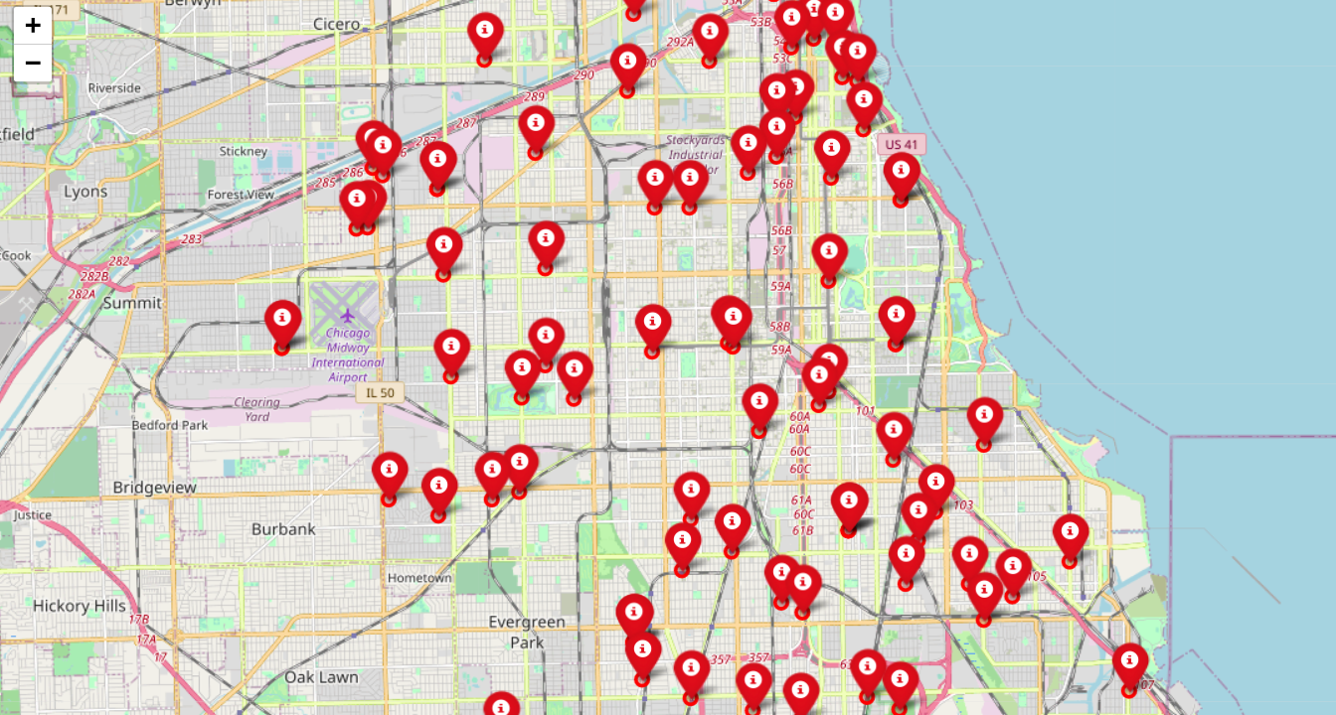
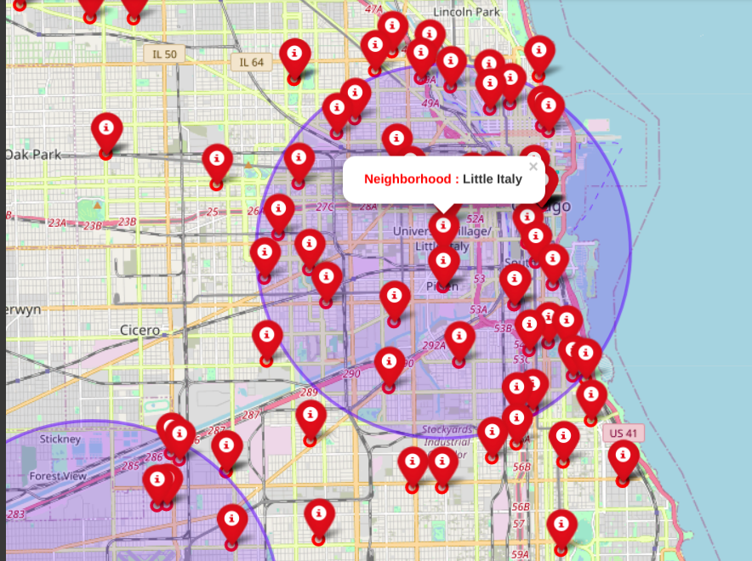
Visualizing the best place for new startup
Red Markers are where there are no restaurants Circle Markers are best places for startup

Slide 11
Conclusion
Best place in CHICAGO to find INDIAN restaurant : West Ridge (it has 17 INDIAN restaurants)
Best restaurant in West Ridge to have dinner : TAHOORA (it has got 7.8 ratings and 49 likes)
Best place for entrepreneur to start business : Little Italy,Lilydale,Clearing

